Slide 1
TRANSFERRING DESIGN TO BODY BLANK
Cut out the top and side (profile) views from a copy of your working drawing. Then, carefully trace the outline of the views onto the wood blank.

Slide 2
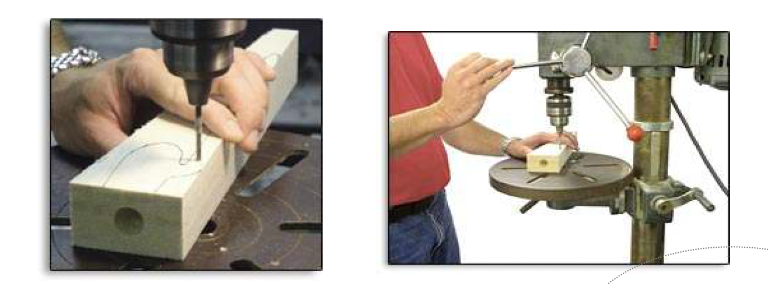
DRILLING AXLE HOLES
1. Transfer the axle hole locations onto the blank by using a sharp pointed tool such as an awl to
puncture through the template and into the wood blank.
2. Lay the car blank on its side and drill 3mm axle pilot holes. The holes should be drilled
perpendicular to the car’s longitudinal axis in order for the car to roll freely and straight down the
track. A drill press is highly recommended because it makes drilling perpendicular holes a cinch.
3. These pilot holes can be enlarged to the size you need later.

Slide 3
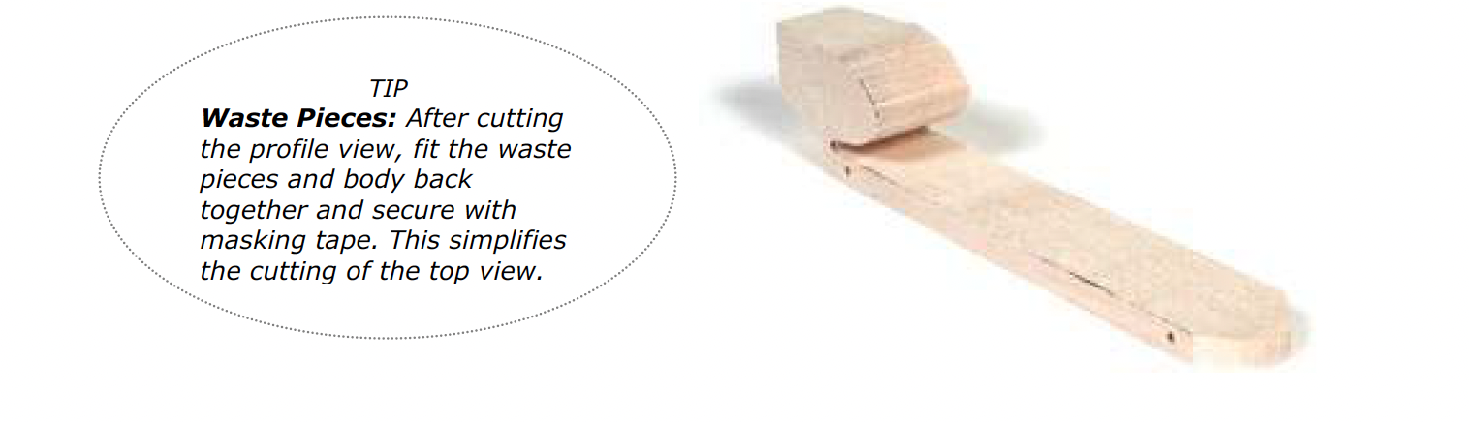
ROUGH SHAPING THE CAR BODY
1. Use a band saw to roughly shape the blank:
a. Turn the blank on its side and cut out the profile view first.
b. Fit the waste pieces and working piece back together and secure them by wrapping two bands of masking tape
around the assembly.
c. Set the blank assembly upright and cut out the top view.
d. Remove the masking tape and discard all the waste pieces.

Slide 4
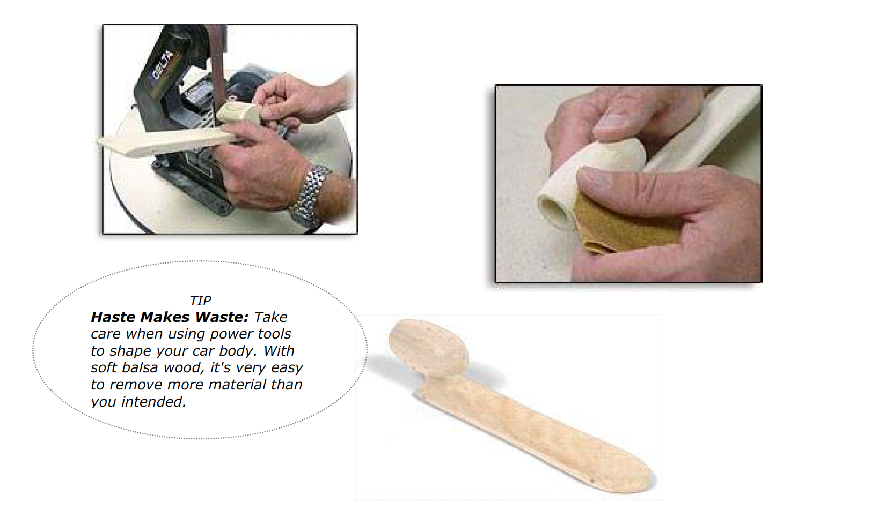
2. Smooth the corners of your car body. Use a bench-mounted sander, sharp knife, wood rasp, files, or rough sandpaper (80 grit) to smooth the car to its basic rounded shape.

Slide 5
3. Periodically check your car against the spec sheet (especially weight) to make sure the car is still within tolerances. When weighing your car, put the wheels, axles, washers, screw eyes, and any other necessary hardware on the scale along with the body. Allow for the weight of paint coats too.
If your design calls for a hollowed-out body, a high-speed rotary multi-tool works nicely. A variety of milling and sanding bits are helpful for making cavities in the car body. When using power tools to shape the car body, go slowly and cautiously. It’s very easy to remove too much wood and ruin your car!

Slide 6
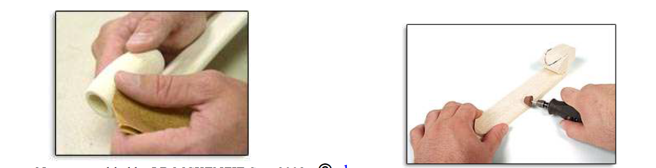
FINE SHAPING THE CAR BODY
At this point, your car has assumed its basic shape. Now you’re at the stage that separates the really fine cars from the mediocre cars. Extra time and effort spent during the fine shaping, or pre-painting, stage have a huge payoff in the kerbside appeal of the final product.
Use sandpaper to remove unwanted bumps and irregularities from the body. Use progressively finer grit paper as you go. For example, you might start with 80-grit paper (very course, removes a lot of material) and progress to 220-grit (fine paper for smoothing surfaces).

Slide 7
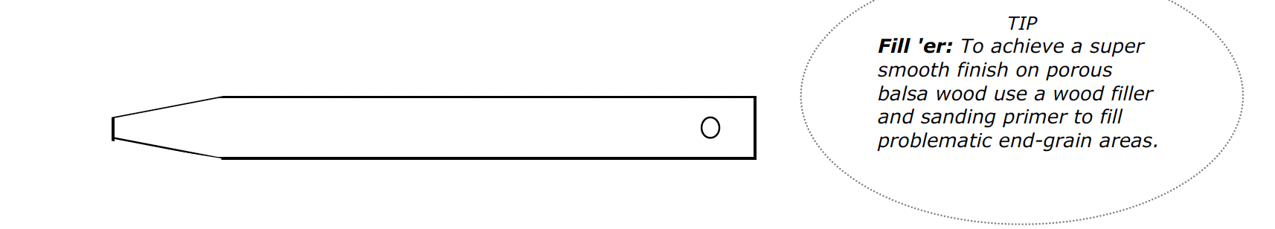
PAINTING YOUR CAR BODY
As in the fine shaping stage, extra patience and effort put into the finishing stage can pay big dividends.
Be aware that using several coats of paint can add weight to your car.
1. Make up a handle and hanger. Cut a 500mm length of flat cut (5mm X 18mm approx) timber. Slightly sand off the edges at one end and drill a hole in the other.
2. Insert the handle into the power plant housing of the car body so that the timber jams slightly
against the sides of the power plant hole. Enough to hold it on the handle when it is hanging down.
This makes a very convenient handle for turning the body to paint it from all angles and you can
hang it from a nail over a drip container while the paint dries.
3. Apply undercoat and sand between coats. You can dip the car body into a deep tall vessel, such as
an old vase, filled with the paint and let it hang to dry
4. Use a spray can or airbrush to apply paint to

Slide 8
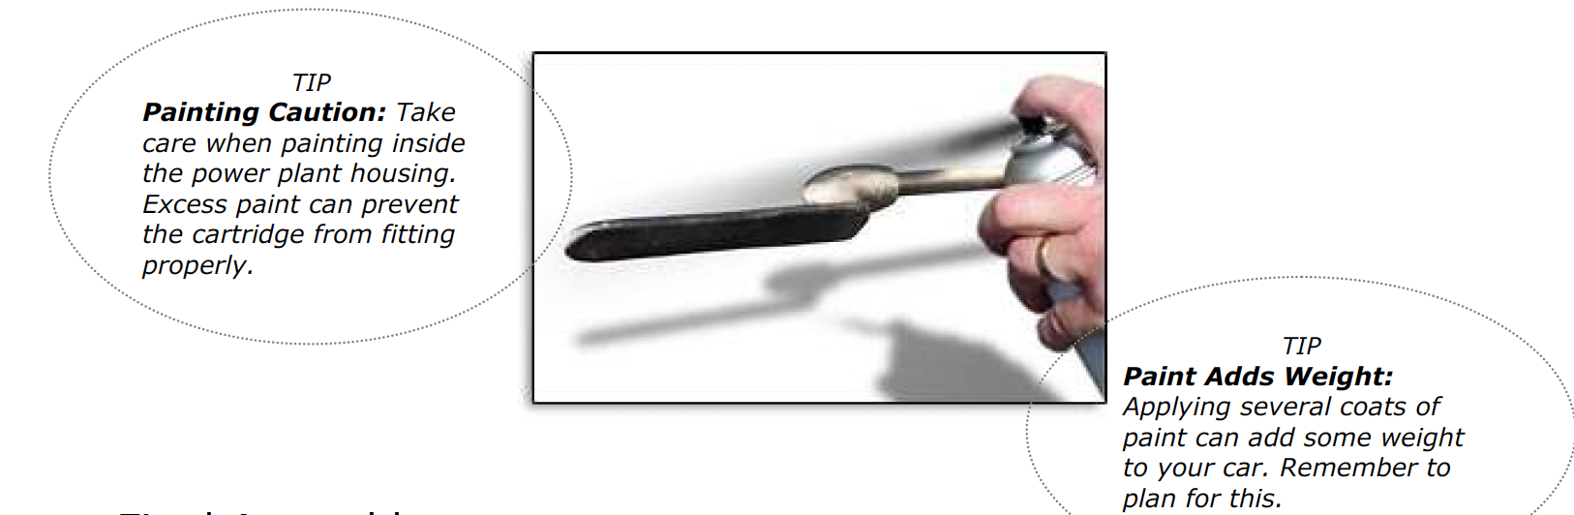

Slide 9
Final Assembly: Mounting Wheels and Hardware
Don’t overlook the importance of this stage. A huge factor in race performance is how smoothly the car
rolls down the track. Some meticulously shaped cars have failed to finish races because of improperly
installed hardware!
1. Gather your hardware: two axles, two straw bearings, four wheels, four washers, and two screw eyes. Depending on the configuration of the car body, different hardware might be required. Shell cars (with internal wheels) often require wheel spacers and clips to affix the axles to the car body.

Slide 10
2. Check your spec sheet for rules about wheels, axles, washers, and spacers.
3. Check that the wheels have no plastic joining tabs on the rims. If they do, trim them off with a craft knife.
4. Carefully mount the wheels and axles as dictated by your design. Be careful not to damage the fragile car body during installation.
5. Roll test the car on a smooth, horizontal surface. The car should roll freely, and the wheels should spin without restriction. Make adjustments if necessary.
Install the screw eyes on the underside of the car body. Important: Plan the location of the screw eyes so
the guideline does not rub against the car body or wheels.

Slide 11
Document the Process
You are now ready to start making! But you need to document all the learning you’re about to have (including any failures).
Complete the following PPT pages – 1 for each key step in the process. Duplicate the first slide to add as many steps as needed. Take photos and add annotations (even videos or sound recordings). Feel free to modify the templates.

Slide 12
Time
Step 1
Tools Required
Safety considerations
Duplicate this slide for each step
Add photos and annotations here
Failures / new skills learnt
Changes to original plan /design

Slide 13
Final Product
Instructions: take photos of your final C02 racer in the light box and insert here

Slide 14
Checklist before you submit
I have all of the steps required with the time taken
I have described the process taken in achieving each step
I have listed the resources needed along with any safety concerns/risks
I have inserted appropriate images demonstrating processes in creation
I have taken photos of each of my products in the light box and inserted these in the last slide (1 per slide)

